Slide 1






Enroute-Genie
Rashmi Nalwad
Ravi Raju Krishna
A Coherent 1-Stop solution to explore the world
www.enroute-genie.com https://github.com/raviraju/Enroute-Genie

Slide 2

Our Software Carpet emerged from IIW course at WPH B27
Aladdin's ancient carpet was found in the Cave of Wonders' treasure room

Slide 3
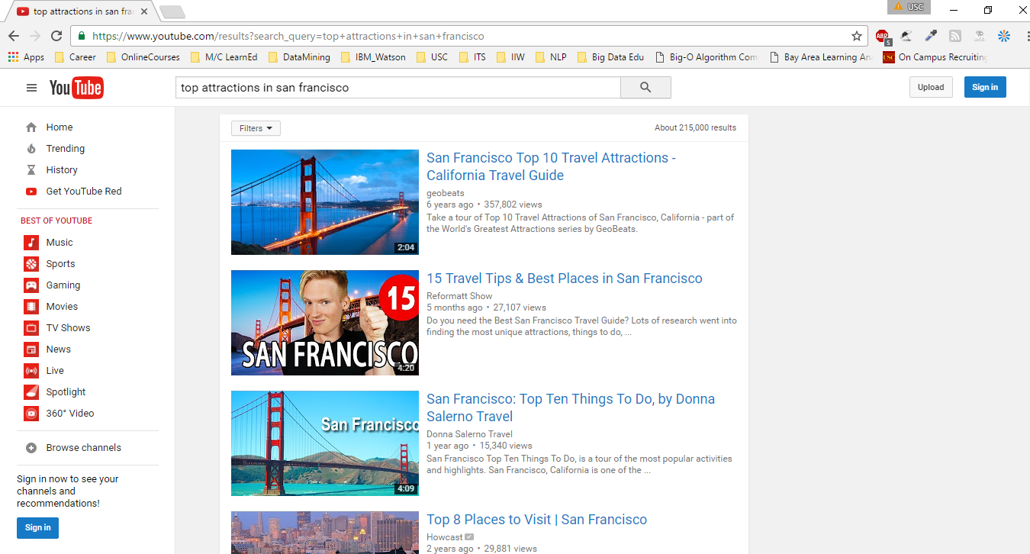
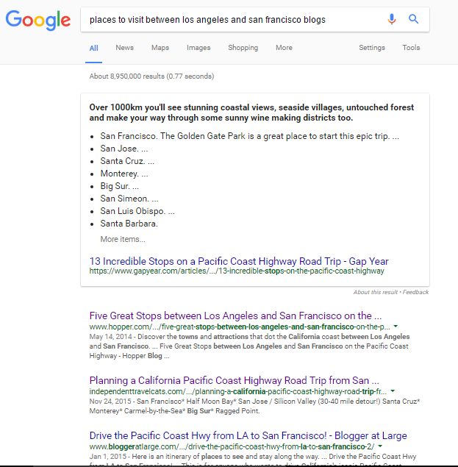
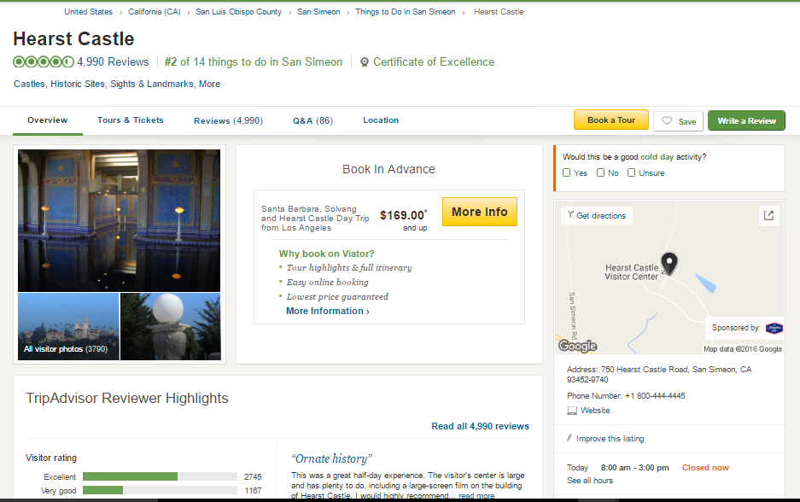
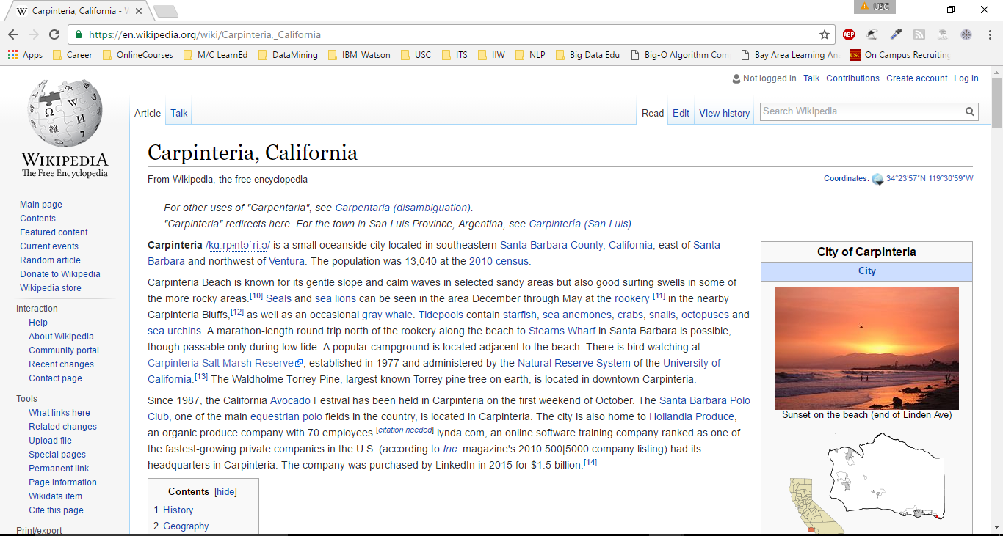
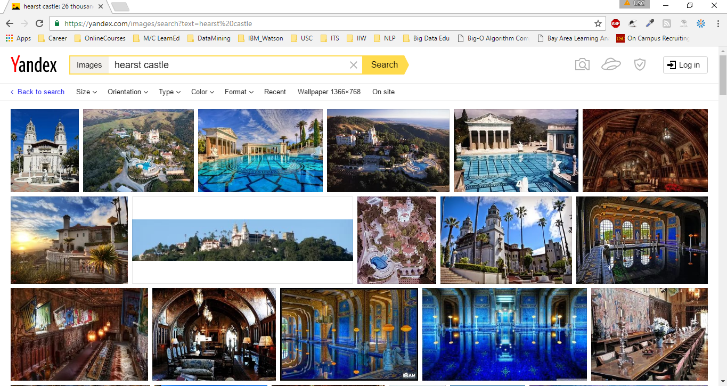

Slide 4
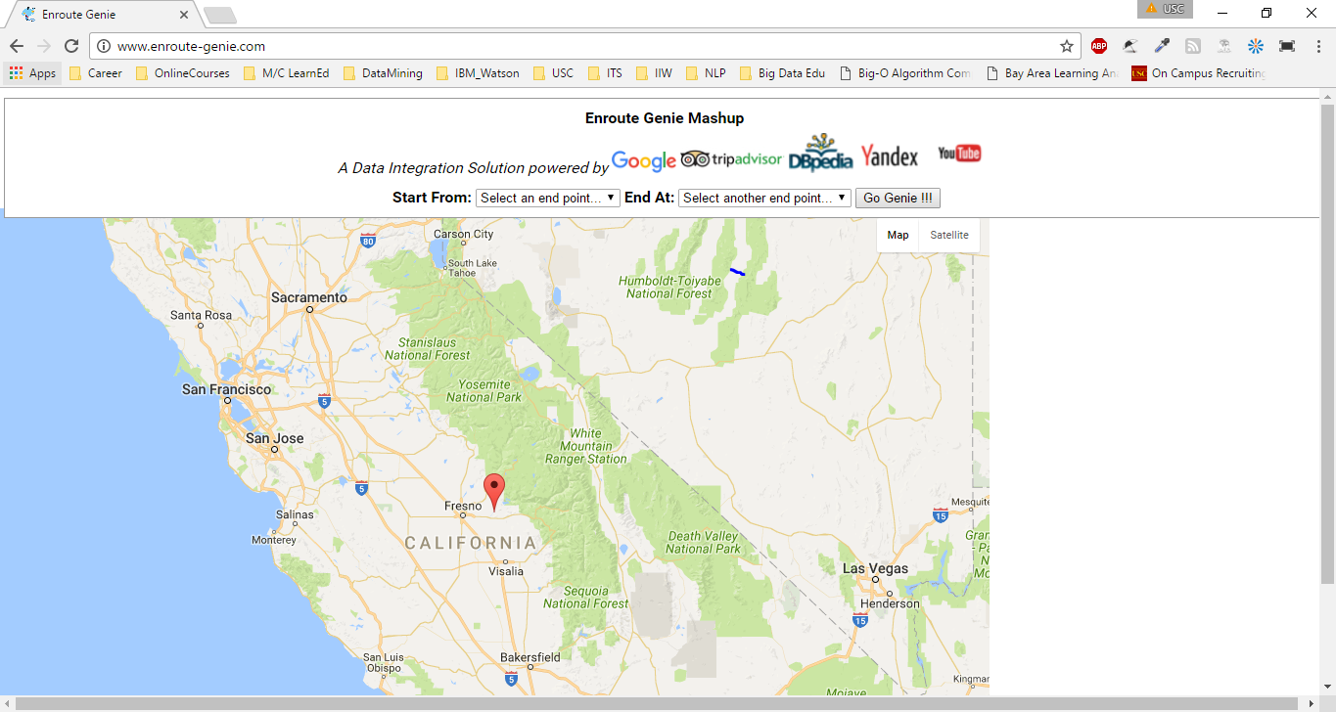
Enroute Genie Snapshot

Slide 5
Learning Objectives of Course | Project Objectives
Understand the theory and techniques of traditional data integration, including logical view integration, schema mapping, and record linkage | Link Records from Google, TripAdvisor & DBPedia
Understand the foundations and techniques of the Semantic Web, including RDF, OWL, SPARQL, linked data | Query data from DBPedia – the semantic web version of Wikipedia, and add HTTP URI to rdf sources adhering to principles of linked data
Understand the theory and application of the state-of-the-art software and tools for information extraction | Scrape Location mention from blogs using customized NER
Understand the algorithms and techniques for data cleaning, source modeling, semi-structured extraction, and information extraction | Configure an Instance based Wrapper Induction Extraction system to fetch structured information from TripAdvisor and use Trifacta Wrangler to refine the results.
For any given integration problem, be able to select and apply the most relevant information integration techniques to solve that problem | Build Enroute-Genie

Slide 6
Modest Goals of data integration system
User Effort : To build tools that reduce the effort required to integrate a set of data sources. Make it easy to add new sources
* Currently addressing State of California.
* Can be easily extended to other states.
* Triggered extension to Karnataka, India, during development.
Accuracy : To improve the ability of the system to answer queries in uncertain environments.
* We are using current state of art for NER – StandfordCoreNLP to identify locations.
* Our accuracy improves adapting to future advances in NER
[NOTE : See Evaluation Results for more info…]

Slide 7
Architecture
NoSQL Warehouse
Web Scraper + Stanford NER
Instance-based Wrapper: Portia
SPARQL Query
Web Scraper
YouTube API
Blog Locations from Google
Review Data from TripAdvisor
Abstract, Comment from dbPedia
Photos from Yandex Search
Videos from YouTube

Slide 8
Pipeline
Data Acquisition
Knowledge Deployment
Query & Visualization
Entity Linking & Data Cleaning

Slide 9
Data Sources
Variety dimension in 3 V’s of Big Data
Unstructured : Blog text Scraped from Google search results
Structured : Abstract and Comment of a city from dbPedia,
TripAdvisor Review Data
Multimedia : Photos and YouTube Videos
Accessed:
Information Extraction
Scraper(Blog Links from Google & ImageUrls from Yandex)
Mine the Deep Web Data : Wrapper(TripAdvisor data)
SPARQL Query(dbPedia Info)
Web Service API(Youtube API)

Slide 10
Data Acquisition
Identify popular destinations of a State
Get geoCode using GeoPy and filter out distant/irrelevant location mentions
Fetch top 3 video URLs using YouTube API
City : top attractions in San Francisco
Location : Golden Gate Bridge
For every pair Google for 'places to visit between ' + city_a + ' and ' + city_b + ' blogs'
Extract Content using Beautiful Soup and get NER Location Annotation from Stanford CoreNLP
Configure an Instance-Based Data extraction wrapper-Portia to extract attraction review metadata
Clean Data using Trifacta Wrangler
Query dbPedia for Abstract and Comment of locations partOf California
Using SPARQL

Slide 11
Entity Linking – using FRIL
Blog Location Mentions
Trip Advisor Review Data
dbPedia Info
Record Linked Data
Edit-Distance : (mention_name,attraction_name), (match-level-start=0.1, math-level-end=0.3) weight="50"
Numeric-Distance : (mention_latitude, attraction_latitude)
exactMatch
weight="25"
Numeric-Distance : (mention_longitude, attraction_longitude)
exactMatch
weight="25"

Slide 12


Enrich Record Linked Data
Sentiment Analysis on Review Comments using TextBlob
Neutral Review
Negative Review
Positive Review
Fetch Images from Yandex Search Engine

Slide 13

Knowledge Deployment
Integrated Data loaded to NoSQL-CouchDB
Web Service to share our integrated data with other applications:
HTTP API Access to our DB
https://enroutegenie.cloudant.com/enroute_genie/_all_docs
https://enroutegenie.cloudant.com/enroute_genie/los%20angeles_and_san%20francisco

Slide 14
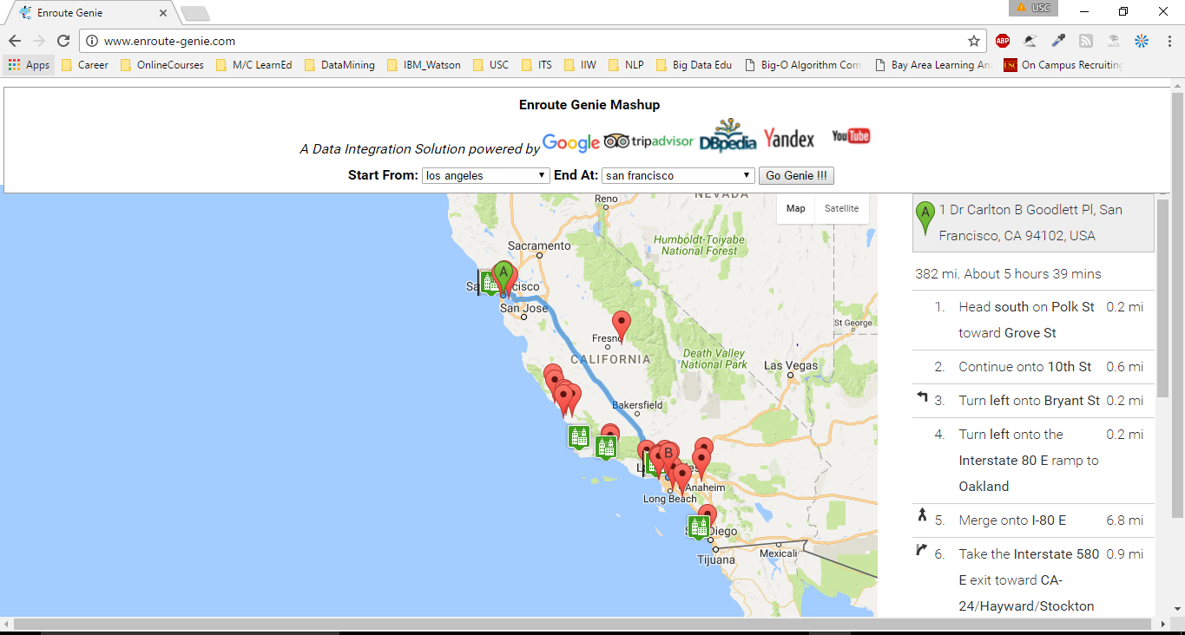
Query & Visualization

Slide 15
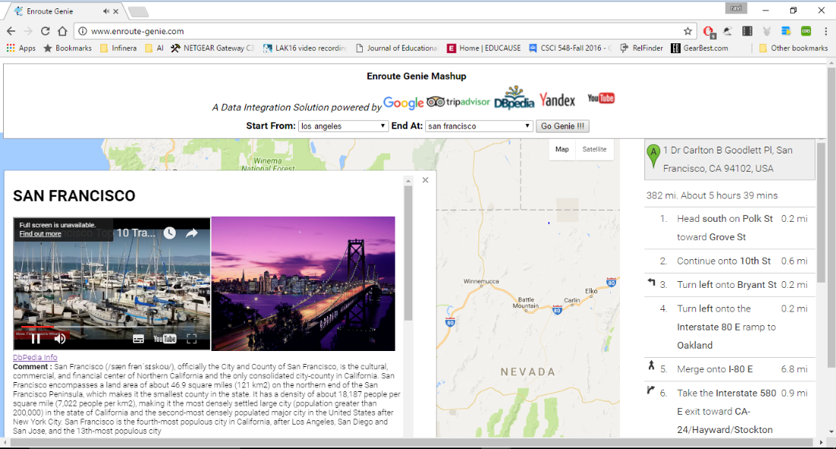
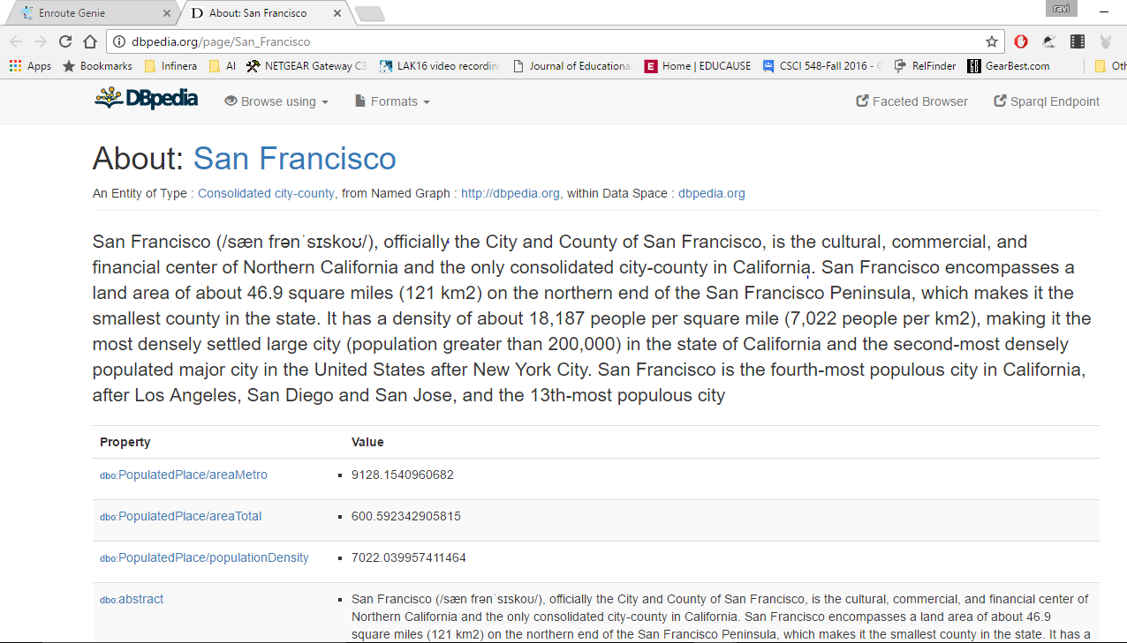
City Attractions

Slide 16
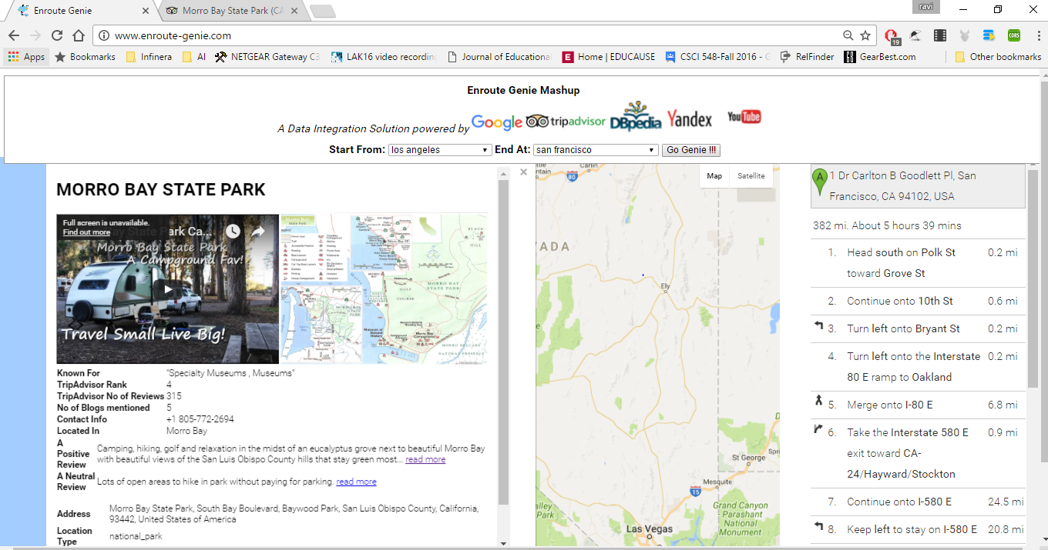
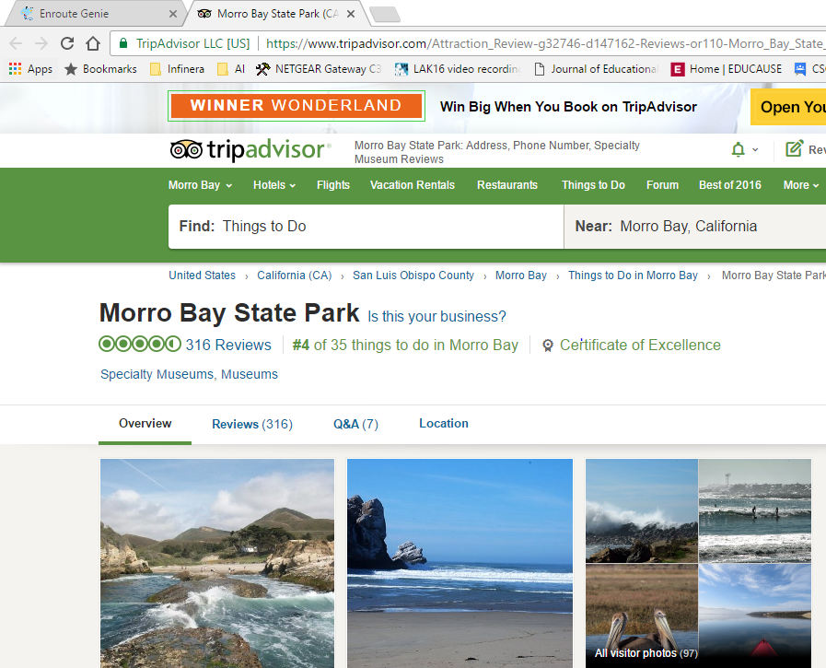
Location Mentions

Slide 17
Evaluation – Los Angeles and San Francisco
NER, Geo-Coded Relevant
(176)
Human Annotated
(166)
(76)

Slide 18
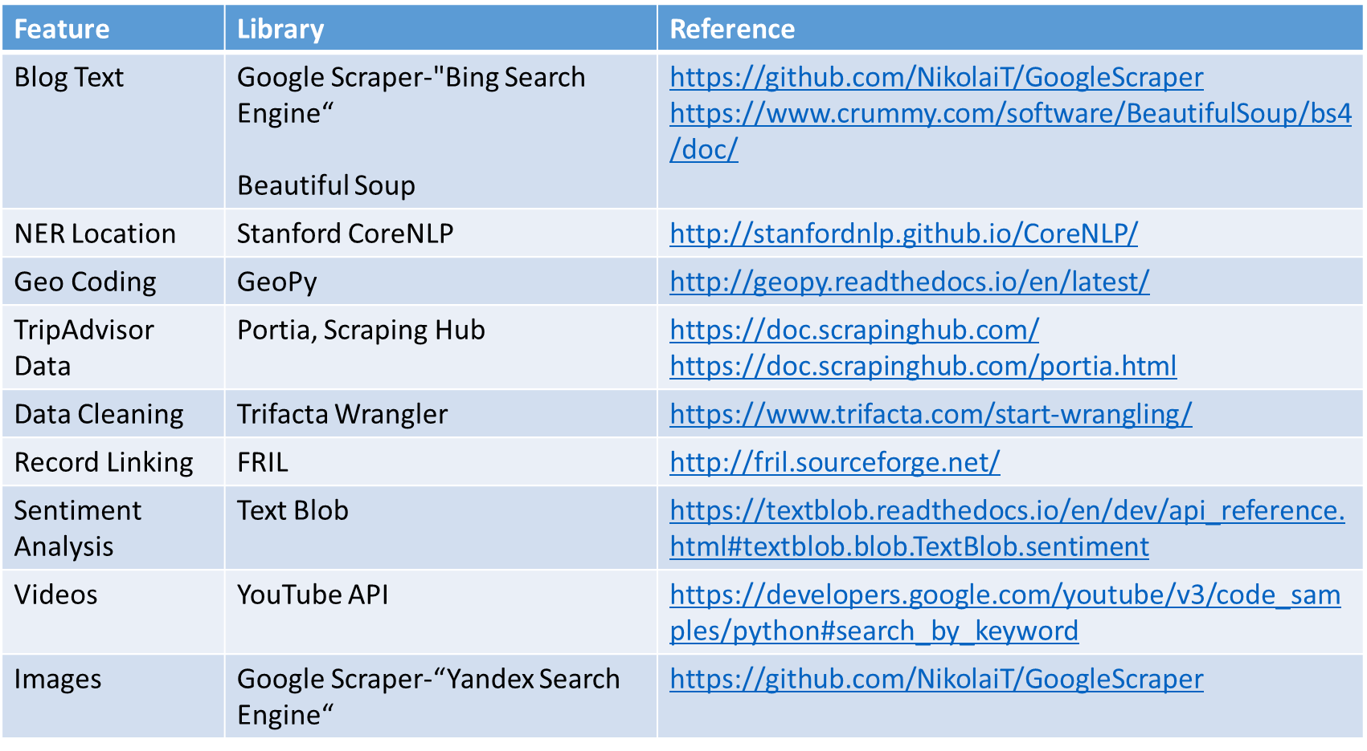

Data Integration or Tools Integration ?

Slide 19
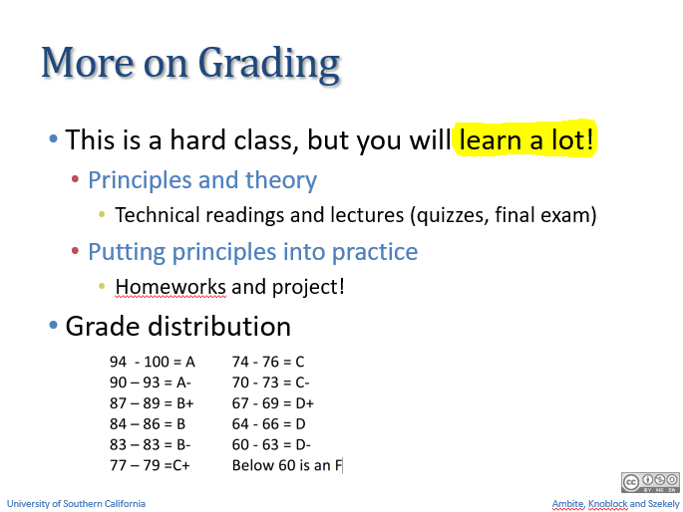

Slide 20

Questions ?

